Slide 1
Machine Learning Project
Network Intrusion Detection Systems
Group members:
Aymen Msalmi
Mohamed Louay Njima
Fedi Baccar
Alaeddine Rassaa
Fadi Kharroubi
Youssef Ammar
Akrem Mahmoud

Slide 2
Business Understanding
Modeling
01
04
Data Understanding
Evaluation
02
05
Data Preparation
03
06
Deployment
Table of contents
Individual Models
Ensemble Learning Models
What are IDS?
Project Focus and Objectives
Project Phases
Dataset characteristics and files
Data Exploration and Visualization
Evaluation Metrics
Results Interpretation
Data Cleaning
Data Transformation

Slide 3
01
Business Understanding

Slide 4
What are Intrusion Detection Systems?
Security Mechanism
Protect network or system activities for malicious activities.
Detect anomalous patterns that compromise the integrity and security of a network
Identify and respond to anomalies indicative of a security threat.

Slide 5
Project objectives
Signature-based detection.
Supervised learning: KNN, SVM, Decision tree, logistic regression Random forest.
Anomaly-based detection.
Unsupervised clustering.
Supervised learning:Decision tree , MLP.
Develop a robust Intrusion Detection System that leverages machine learning to identify and mitigate malicious activities.
For this, we focus on reproducing two competitive and different approaches discussed in research papers.
Paper 1
Paper 2

Slide 6
Signature-based VS. Anomaly-based?
It relies on a database of predefined signatures or patterns of known attacks.
Detection Method:
It works by comparing network traffic, system behavior, or file characteristics against a database of known attack signatures.
Advantages:
High accuracy for known threats.
Limitations:
Ineffective against new, previously unseen threats (zero-day attacks).
It focuses on identifying deviations from established normal behavior.
Detection Method:
It establishes a baseline of normal network traffic and triggers an alert when activities deviate significantly from this baseline.
Advantages:
Effective at detecting previously unknown threats or zero-day attacks.
Limitations:
Difficulty in accurately defining what constitutes "normal" behavior.

Slide 7
Signature-based VS. Anomaly-based?
Signature-based detectors check if the collected samples match with known attacks, whereas anomaly-based detectors build statistical models that characterize normal behavior and look for abnormal patterns. => The ability to detect new attacks that aren’t necessarily known.
R2L attack
Normal traffic
U2R attack
Probe attack
DoS attack
? traffic
Anomaly
Signature-based Detection
Anomaly-based Detection

Slide 8
Project Phases
The project follows the CRISP-DM methodology that serves as a guiding framework for successful machine learning projects.
The project is strategically organized into six distinct phases:
Business Understanding
Data
Understanding
Data
Deployment
Data
Preparation
Evaluation
Modeling
Notes:
Agile method
Characterized by iterations and flexibility

Slide 9
02
Data Understanding

Slide 10
Dataset characteristics and files
Data Redundancy
Purpose
Dataset Files:
Relevance
Size
Addressing redundancy issues present in the previous KDD Cup 99 dataset.
Suitable for intrusion detection system research
KDDTrain+.TXT: The full NSL-KDD train set
KDDTest+.TXT: The full NSL-KDD test set
Crucial due to the scarcity of public datasets for network-based IDS
Reasonable size in training and test datasets

Slide 11
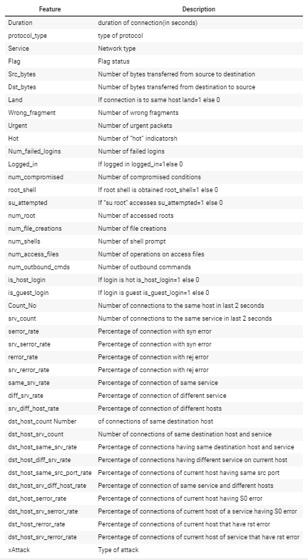
Data Exploration and Visualization
The dataset is composed of 41 features.
The inclusion of these features aims to capture diverse aspects of network interactions

Slide 12
Data Exploration and Visualization
To enhance clarity and simplify analysis, we've grouped attack subclasses into 4 main categories:
Probe: Involves attempts to gather information about a network or system's vulnerabilities.
DoS: Aims to disrupt or disable network services or resources.
U2R: Attempts to gain unauthorized root access to a system.
R2L: Attempts to gain unauthorized access to a local network from a remote user.

Slide 13
Data Exploration and Visualization
Buffer_overflow
Loadmodule
Sqlattack
Xterm
Rootkit
Perl
Ps
Portsweep
Ipsweep
Nmap
Satan
Mscan
Saint
Ftp_write
Guess_passwd
Snmpgetattack
Snmpguess
Httptunnel
Warezclient
Warezmaster
Multihop
Sendmail
Xsnoop
Named
Xloc, Map, Phf, Spy
processtable
Neptune
Teardrop
Mailbomb
Apache2
Udpstorm
Back
Land
Pod
Smurf
worm
DOS
R2L
U2R
Probe

Slide 14
Distribution of attacks
Normal
0
Normal
Target value
1
DoS
2
U2R
Anomaly
3
R2L
4
Probe
The dataset is labeled : with each instance of network traffic associated with a specific class or label indicating whether it is normal or corresponds to a particular type of intrusion.
Supervised Learning

Slide 15
Data Exploration
Dimension
Data Types
Missing values
Duplicated records
42 columns
148517 rows
22 Integers
16 Floats
4 Objects
No missing values are found in the dataset
0 duplicated values found

Slide 16
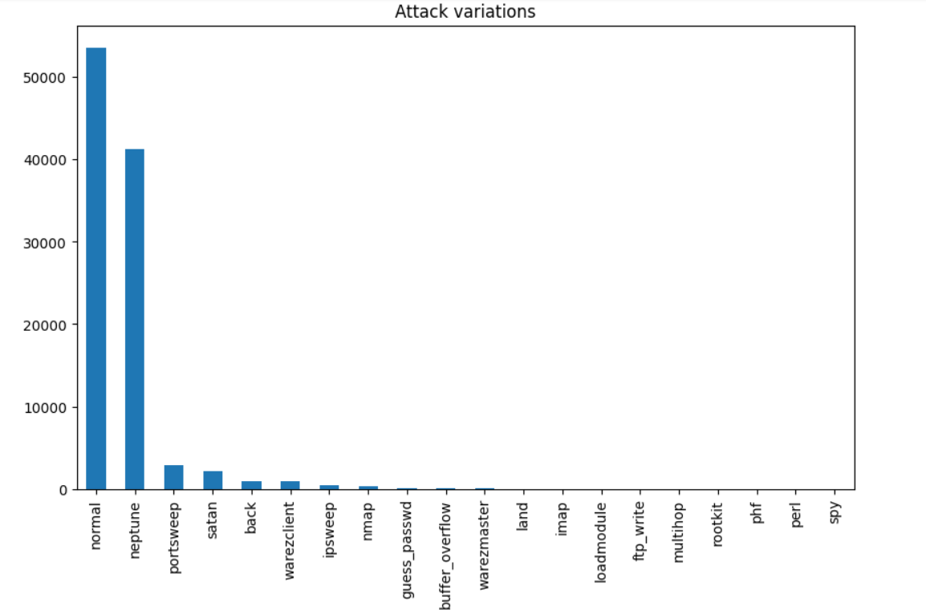
Data Visualization
Attack variations of data train compared with different variables

Slide 17
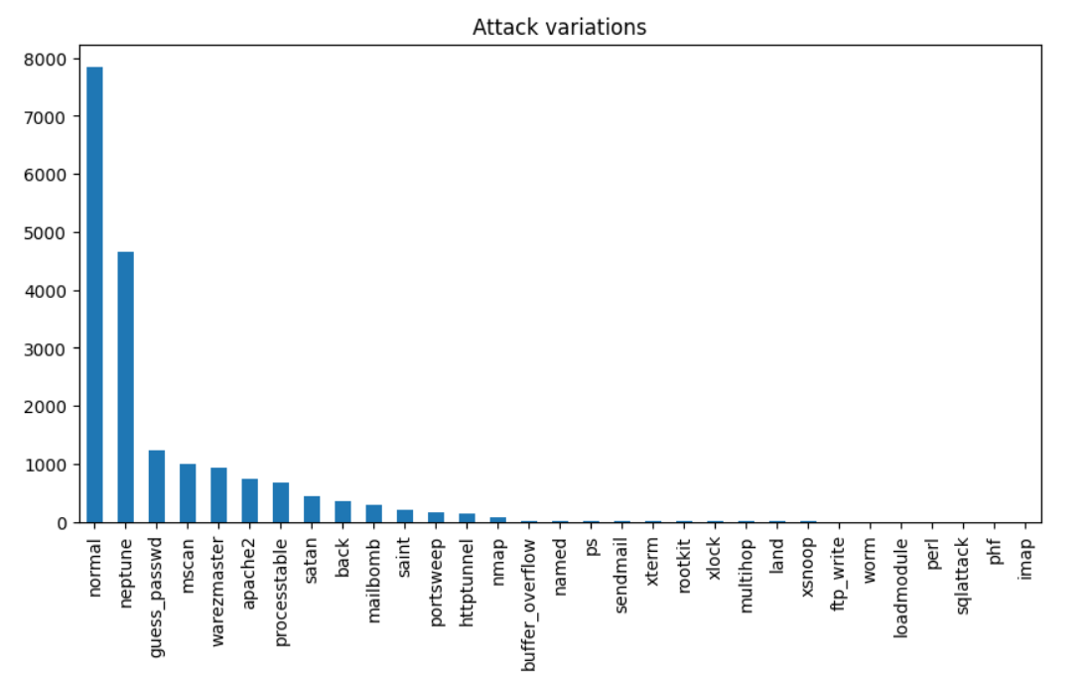
Data Visualization
Attack variations of data test compared with different variables

Slide 18
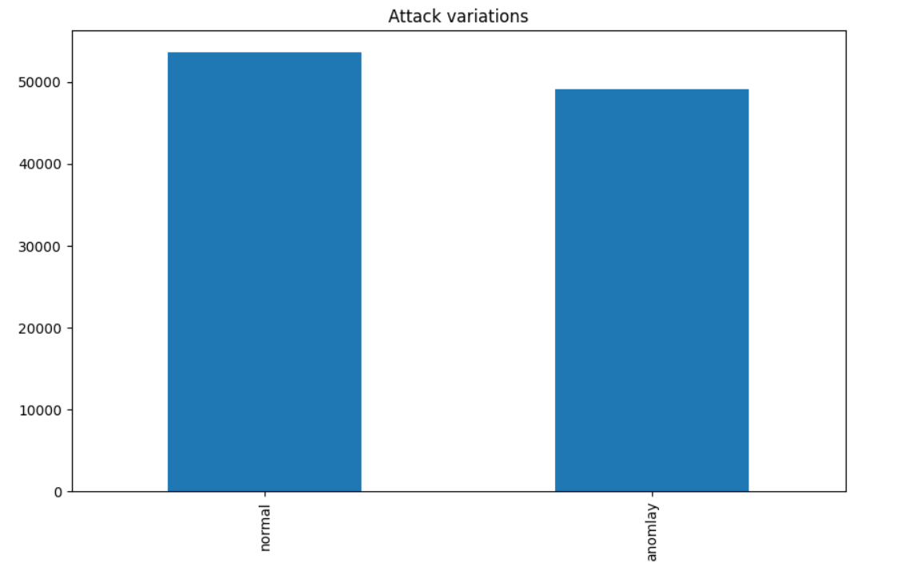
Data Visualization
Attack variations of data train compared with normal and anomaly

Slide 19
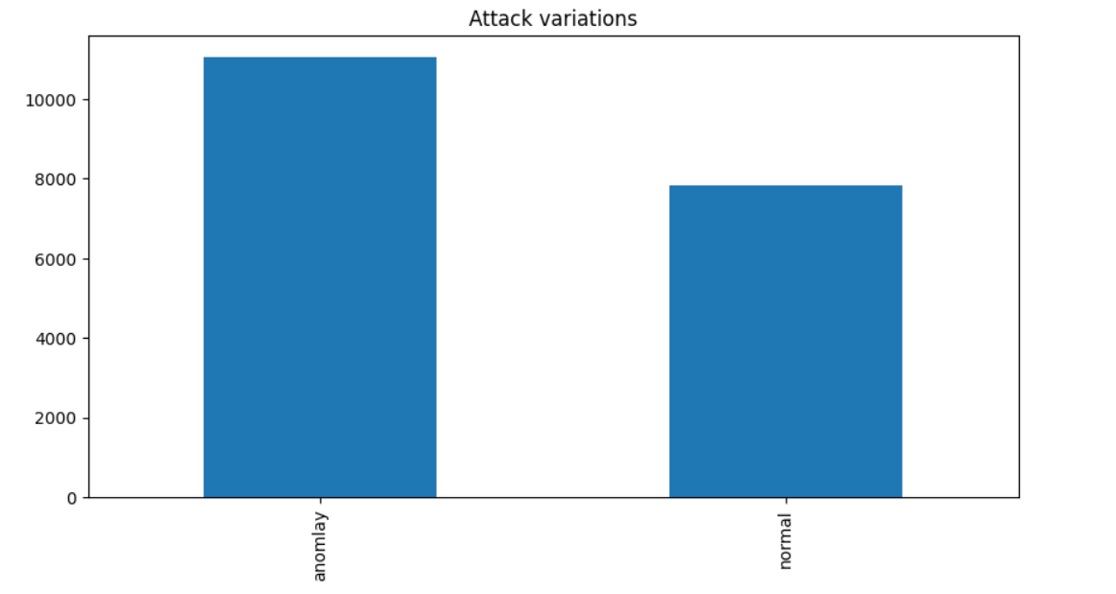
Data Visualization
Attack variations of data test compared with normal and anomaly

Slide 20
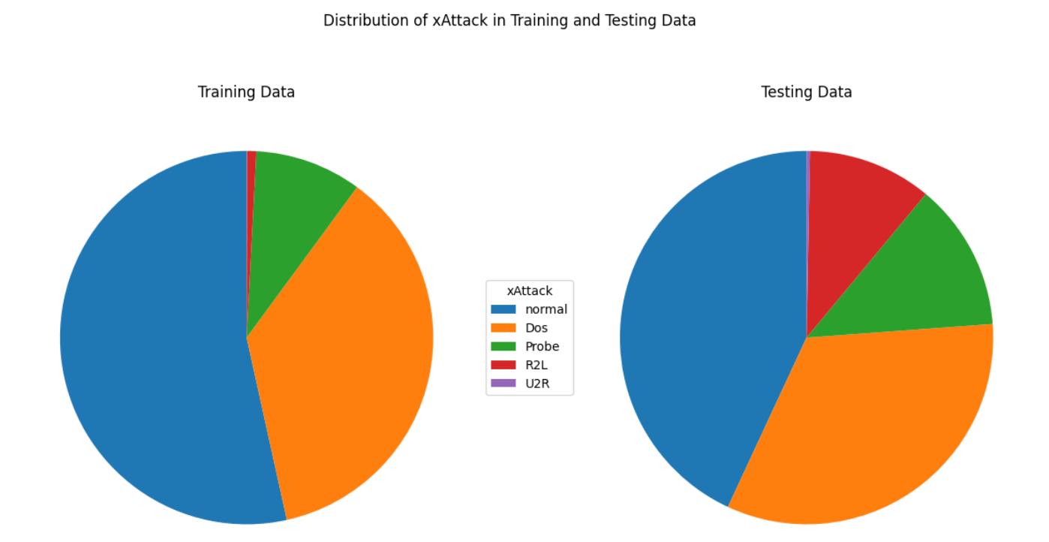
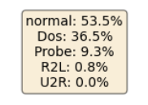
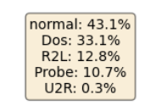
Data Visualization
Dataset distribution visualization based on main attack categories

Slide 21
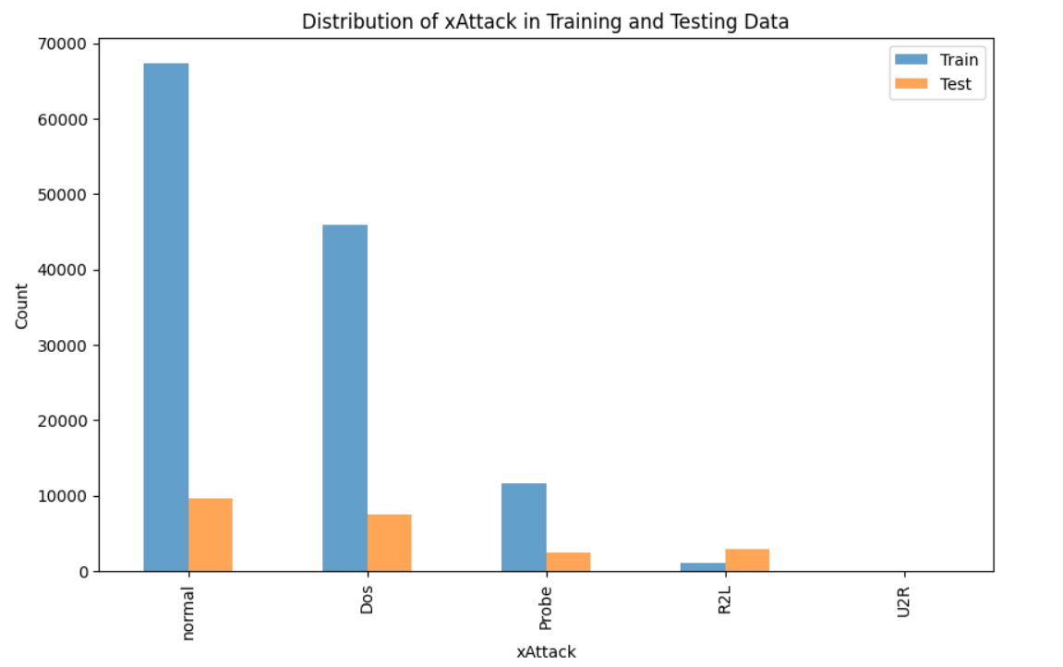
Data Visualization
Dataset distribution visualization based on main attack categories

Slide 22
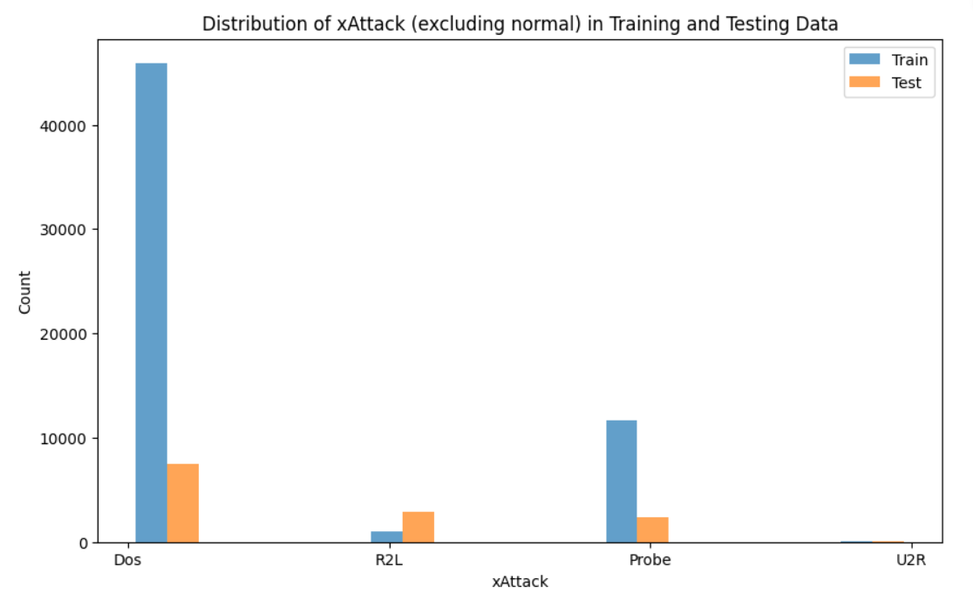
Data Visualization

Slide 23
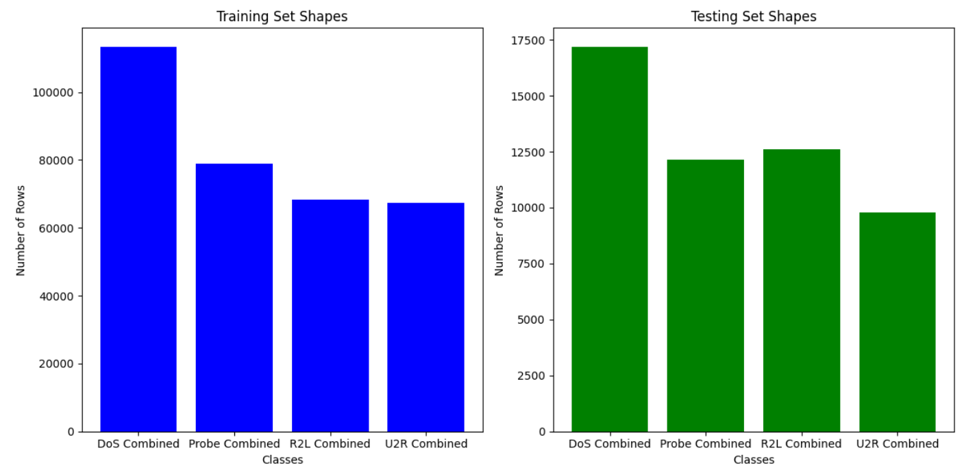
Data Visualization

Slide 24
Paper 1

Slide 25
03
Data Preparation

Slide 26
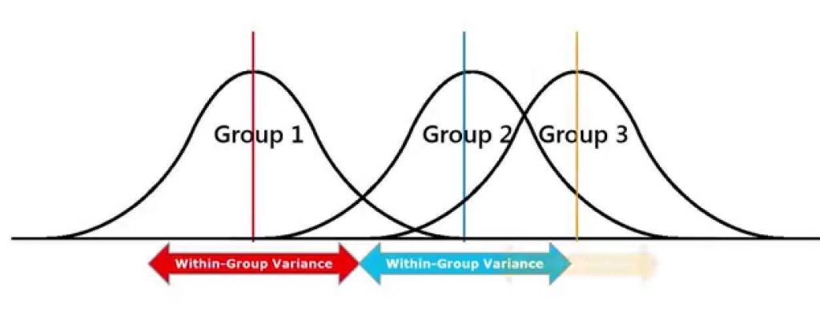
Data Transformation
Categorical Features Encoding :
Encoding 'xAttack' column using Ordinal Encoding
Encoding the categorical features (flag, service, protocol_type) using OneHotEncoder
Feature selection using ANOVA:
retaining only features that exhibit a substantial impact on the target label

Slide 27
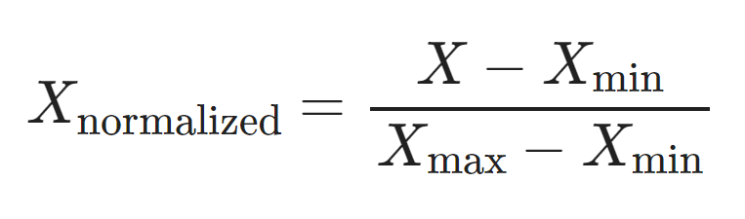
Data Transformation
Scaling Features:
scaling numerical features to a specific range, usually between 0 and 1 using Min-Max normalization
ensuring that all features contribute equally to the analysis by eliminating the influence of varying scales.
Data Partitioning :
Dividing the dataset into two parts:
X_attack, containing all features (excluding 'xAttack')
y_attack, exclusively comprising the target label 'xAttack'
Clear distinction between input features and the target variable in subsequent analysis steps

Slide 28
04
Modeling

Slide 29
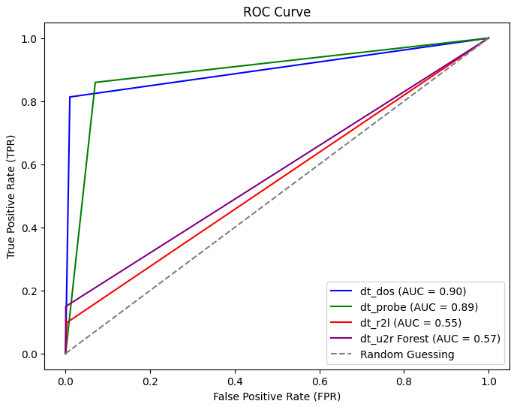
Individual Models
Logistic regression
Logistic regression
Logistic regression
Logistic regression
Dos
Probe
R2L
U2R
Accuracy: 0.97
Precision: 0.98
Recall: 0.95
F1 Score: 0.96
Accuracy: 0.983
Precision: 0.946
Recall: 0.974
F1 Score: 0.96
Accuracy: 0.964
Precision: 0.9
Recall: 0.952
F1 Score: 0.925
Accuracy: 0.996
Precision: 0.982
Recall: 0.828
F1 Score: 0.89

Slide 30
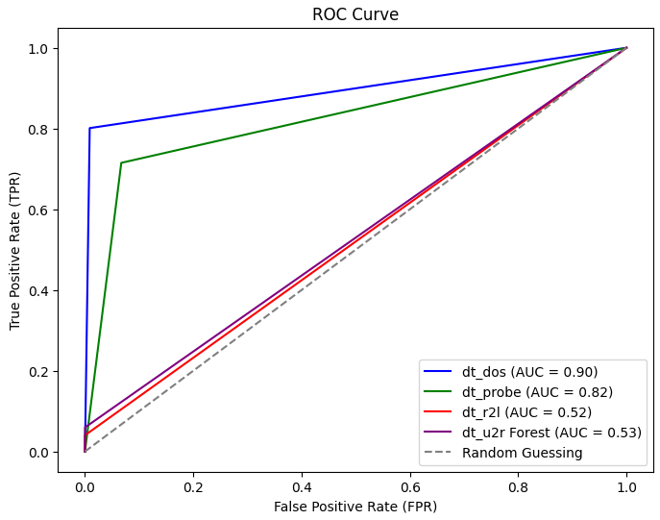
Individual Models
KNN(K-nearest neighbour)
KNN(K-nearest neighbour)
KNN(K-nearest neighbour)
KNN(K-nearest neighbour)
Dos
Probe
R2L
U2R
Accuracy: 0.995
Precision: 0.997
Recall: 0.991
F1 Score: 0.994
Accuracy: 0.99
Precision: 0.988
Recall: 0.965
F1 Score: 0.976
Accuracy: 0.969
Precision: 0.957
Recall: 0.906
F1 Score: 0.930
Accuracy: 0.996
Precision: 0.85
Recall: 0.871
F1 Score: 0.839

Slide 31
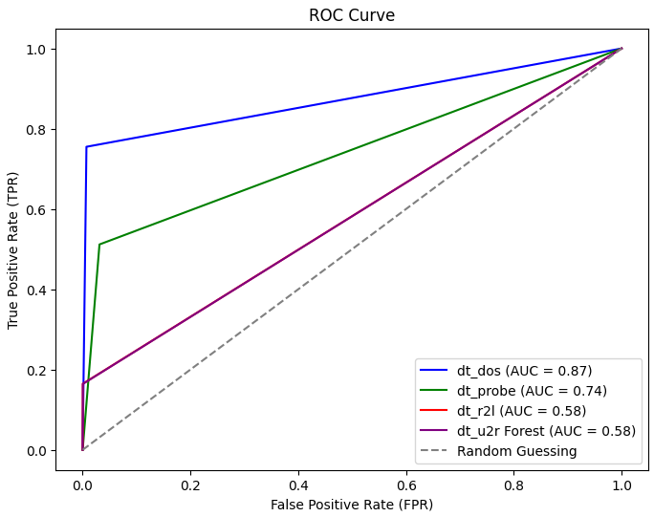
Individual Models
Decision Tree
Decision Tree
Decision Tree
Decision Tree
Dos
Probe
R2L
U2R
Accuracy: 0.993
Precision: 0.992
Recall: 0.991
F1 Score: 0.992
Accuracy: 0.993
Precision: 0.982
Recall: 0.982
F1 Score: 0.982
Accuracy: 0.981
Precision: 0.956
Recall: 0.957
F1 Score: 0.957
Accuracy: 0.997
Precision: 0.839
Recall: 0.816
F1 Score: 0.805
Notes:
Un arbre de décision est un modèle d'apprentissage automatique qui prend des décisions basées sur les caractéristiques des données. Il est représenté sous forme d'arbre, où chaque branche conduit à une décision finale. C'est souvent utilisé pour la classification et la régression, offrant une approche intuitive de la prise de décision.

Slide 32
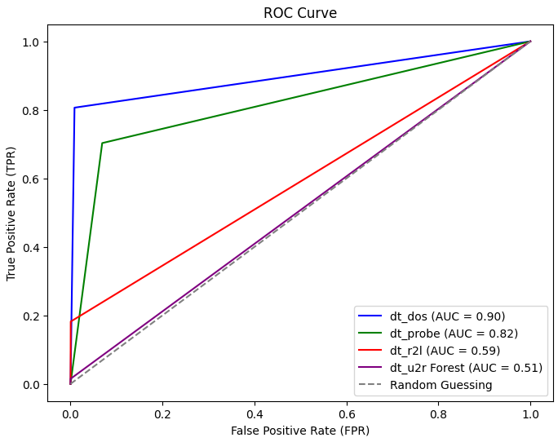
Individual Models
SVM
SVM
SVM
SVM
Dos
Probe
R2L
U2R
Accuracy: 0.911
Precision: 0.986
Recall: 0.806
F1 Score: 0.887
Accuracy: 0.885
Precision: 0.871
Recall: 0.803
F1 Score: 0.81
Accuracy: 0.812
Precision: 0.992
Recall: 0.18
F1 Score: 0.307
Accuracy: 0.993
Precision: 0.333
Recall: 0.0149
F1 Score: 0.0285
Notes:
Une machine à vecteurs de support (SVM) est un modèle d'apprentissage automatique qui trouve une frontière de décision optimale entre différentes classes. C'est utilisé pour la classification et la régression, en cherchant à maximiser la marge entre les points de données de différentes catégories dans l'espace des caractéristiques. En résumé, c'est un outil puissant pour la séparation claire des données.

Slide 33
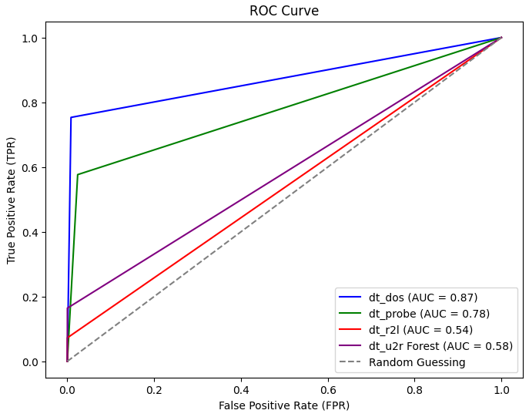
Individual Models
Random Forest
Random Forest
Random Forest
Random Forest
Dos
Probe
R2L
U2R
Accuracy: 0.997
Precision: 0.997
Recall: 0.995
F1 Score: 0.996
Accuracy: 0996
Precision: 0.994
Recall: 0.985
F1 Score: 0.989
Accuracy: 0.98
Precision: 0.962
Recall: 0.955
F1 Score: 0.959
Accuracy: 0.997
Precision: 0.875
Recall: 0.792
F1 Score: 0.795
Notes:
La forêt aléatoire est un modèle qui combine plusieurs arbres de décision pour une meilleure performance en classification ou régression. C'est une approche robuste et précise grâce à la diversité des arbres.

Slide 34
05
Evaluation

Slide 35
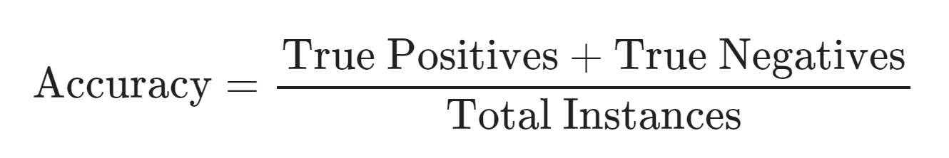
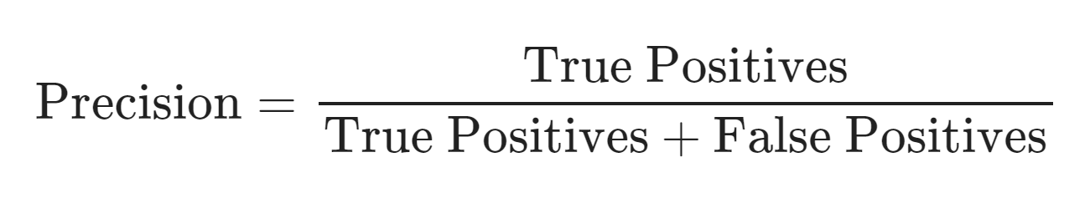
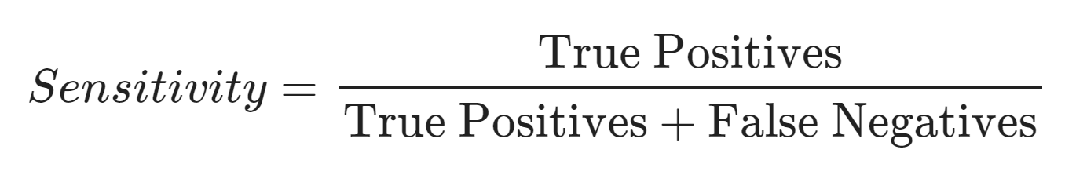
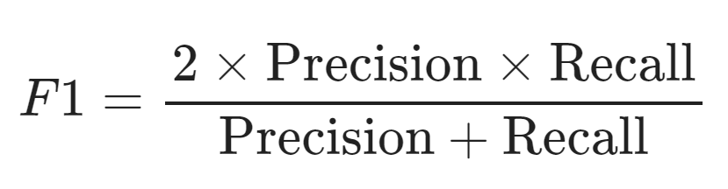
Evaluation metrics
Accuracy: The overall correctness of the model's predictions.
Precision: The accuracy of positive predictions made by the model.
Recall/Sensitivity: The ability of the model to identify all relevant instances (sensitivity).
F1 Score: The harmonic mean of precision and recall, providing a balance between the two metrics.

Slide 36
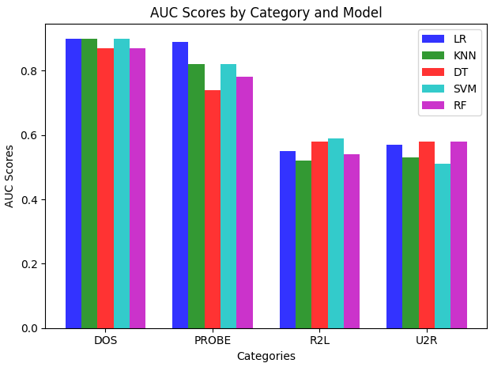
Comparison of Individual Models

Slide 37
Paper 2

Slide 38
03
Data Preparation

Slide 39
Data Cleaning
Dropping duplicates ( there are no duplicates)
Filter rows with the value 'tcp' in the 'protocol_type' column
Dropping Features
Dropping the column 'num_outbound_cmds' as it contained only a single unique value
Removing the 'flag,' 'service,' and 'protocol_type' columns
Dropping columns unrelated which the router should not be able to reach : 'hot', 'num_failed_logins', 'logged_in', 'num_compromised', 'root_shell', 'su_attempted', 'num_root', 'num_file_creations', 'num_shells' … because they are not pertinent for router-related analysis.
Data set size: 120,366 rows, 24 columns

Slide 40
Data Transformation
Categorical Features Encoding :
Ordinal encoding applied to 'class' column : 0 for normal, 1 for anomaly.
Scaling Features:
scaling numerical features to a specific range, usually between 0 and 1 using Min-Max normalization
ensuring that all features contribute equally to the analysis by eliminating the influence of varying scales.

Slide 41
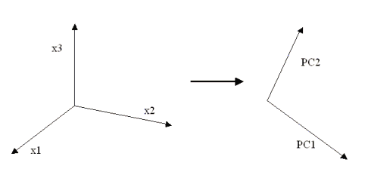
Data Transformation
Principal Component Analysis PCA :
Transforming the data into a new set of uncorrelated variables (principal components)
Consider each generated feature as if it was independent from the others.
Data Partitioning :
Dividing the dataset into two parts:
X_class, containing all features (excluding 'class')
y_class, exclusively comprising the target label 'class'
Clear distinction between input features and the target variable in subsequent analysis steps
.

Slide 42
Data splitting
DATA
No
NORM
[0,1]
Yes
No
Yes
No
Yes
PCA
PCA
No
Yes
No
Yes
No
Yes
No
Yes
FGMPM
FGMPM
FGMPM
FGMPM
d_raw
d_raw_pca
d_norm
d_norm_pca
d_raw_probs
d_raw_pca_probs
d_norm_probs
d_norm_pca_probs
Notes:
We conduct a set of experiments using the same original dataset
We perform two different transformation techniques to the data
in order to cover all the possibilities. We contemplate all the combinations so at
the end we obtain four different datasets

Slide 43
04
Modeling

Slide 44
Feature Gaussian Mixture Probability Model
Calculate probabilities based on the log-likelihood
Compute log-likelihood for each feature
Normalize probabilities for each feature
Fit a GMM with 2 components to the normal samples
Stack the computed probabilities into DataFrames (X_train_probs and X_test_probs)
FGMPM
Notes:
FGMPM, a powerful technique that leverages Gaussian Mixture Models (GMM) with a specific focus on feature probabilities.
Our first step involves training a Gaussian Mixture Model (GMM) with two components, specifically on the normal samples in our dataset. This targeted approach allows us to model the inherent structure of normal behavior.
2 This metric serves as a measure of how well our model captures the characteristics of normal data.

Slide 45
Model Training
K-Means algorithm in its standard clustering approach.
Voting Scheme
Simple multilayer perceptron MLP
Support Vector Machine
A default decision tree classifier.
for every mentioned dataset we build up 5 different models with the following algorithms:

Slide 46
05
Evaluation

Slide 47
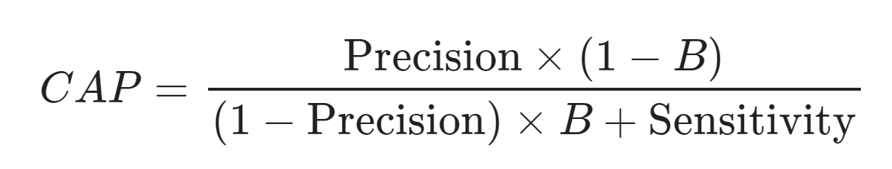
Evaluation metrics
F1 Score
Sensitivity (Positive detection Rate)
Intrusion Detection Capacity (CAP):
It is a cybersecurity metric that gauges the overall effectiveness of an intrusion detection system (IDS) by assessing its ability to correctly identify instances of intrusions while considering the impact of false alarms. This metric encapsulates a balance between precision and sensitivity/recall, incorporating the prevalence of the positive class in the dataset. A higher IDC signifies a more robust IDS that successfully detects true positive intrusions while mitigating false positives..
B: Attack percentage in the whole testing dataset.
Notes:
B: Attack percentage in the whole testing dataset.

Slide 48
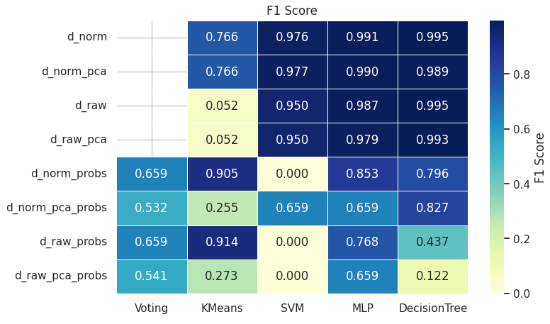

Slide 49
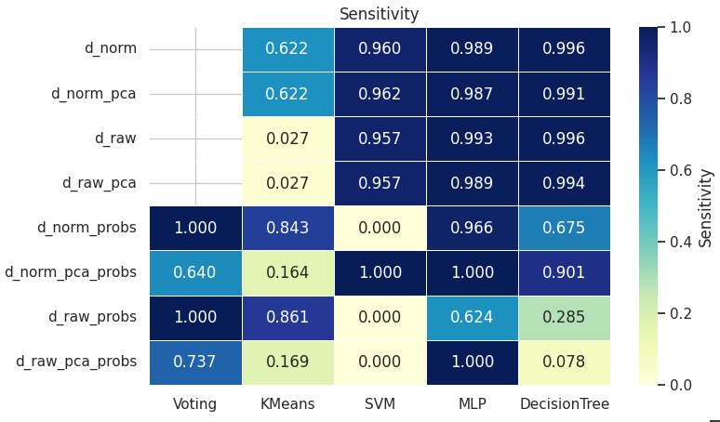

Slide 50
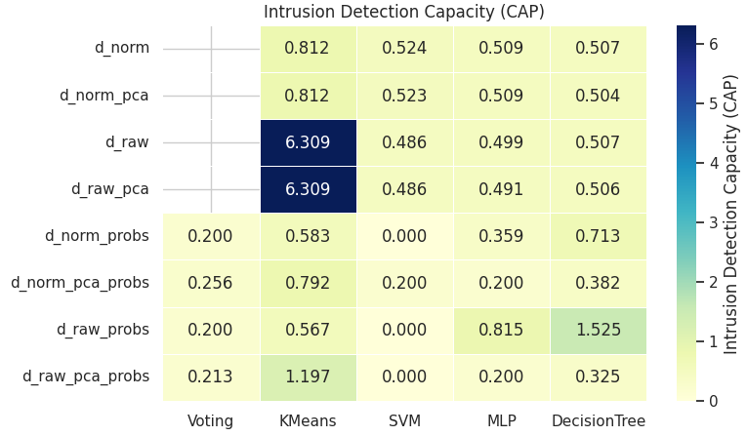

Slide 51
06
Deployment

Slide 52

Deployment Tool
FLASK
Framework Web
April 1, 2010
Python
Supports extensions
Small machine learning projects & simple web applications
‹#›
Notes:
B: Attack percentage in the whole testing dataset.

Slide 53

Deployment Tool
ReactJs
Library for web and native user interfaces
April 1, 2010
Javascript
Supports extensions
Web front-end applications
‹#›
Notes:
B: Attack percentage in the whole testing dataset.

Slide 54
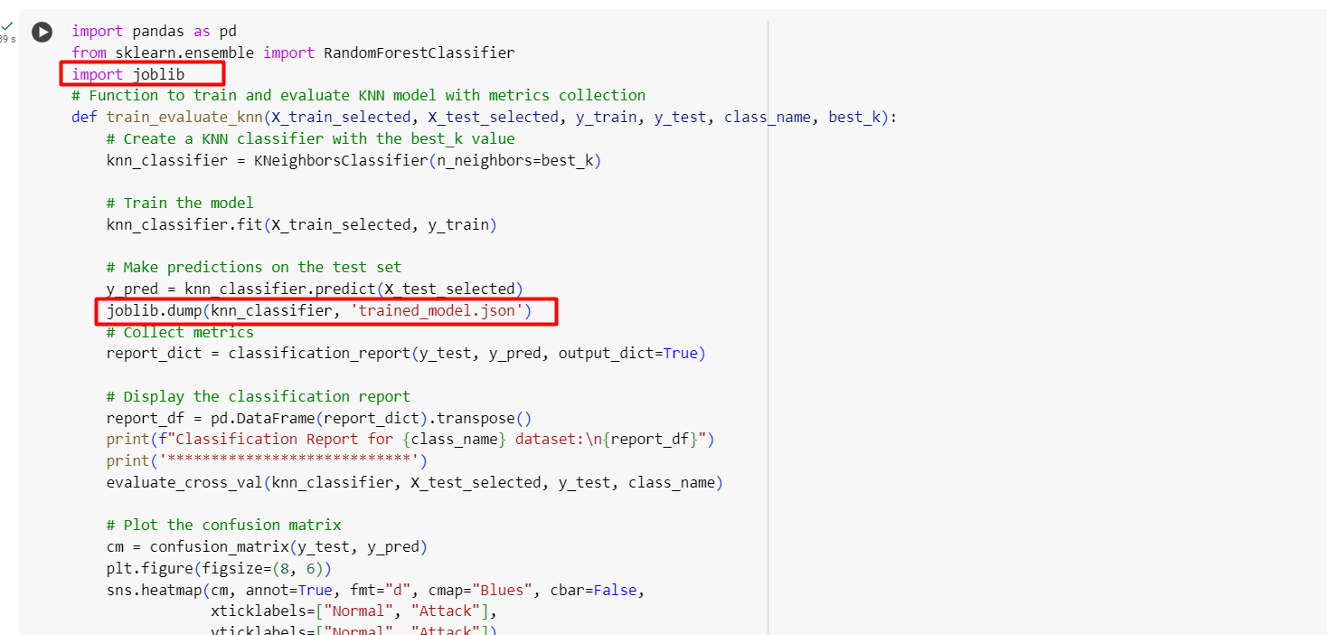
Project Architecture Deployment
After training the model we extracted it on a binary file using the joblib library.
‹#›
Notes:
B: Attack percentage in the whole testing dataset.

Slide 55
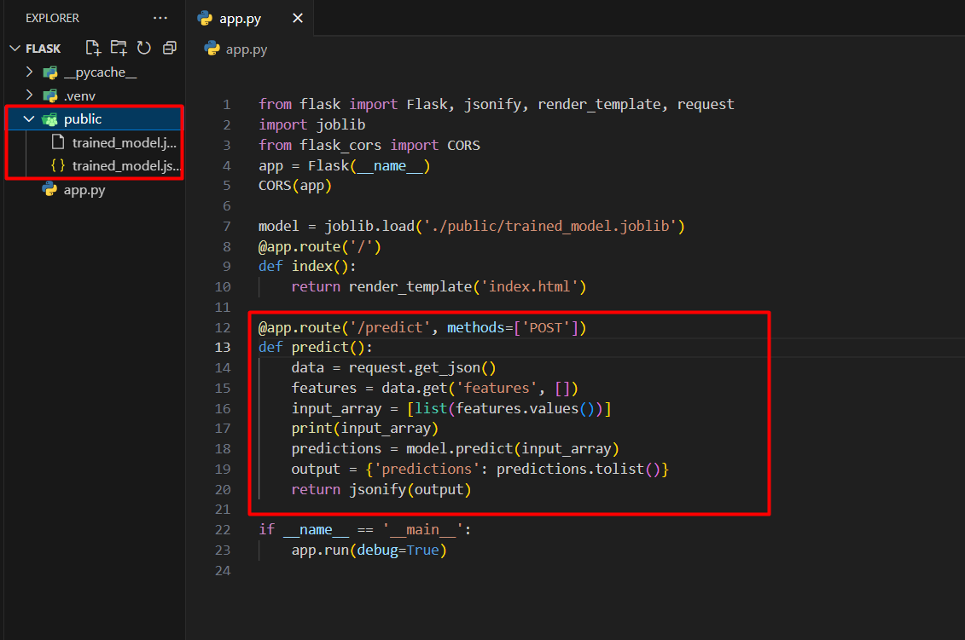
Project Architecture Deployment
Now we upload and load our binary model file on the Back-end project. To expose its functionality we created a route that takes data as an input of the request and returns the prediction value.
‹#›
Notes:
B: Attack percentage in the whole testing dataset.

Slide 56
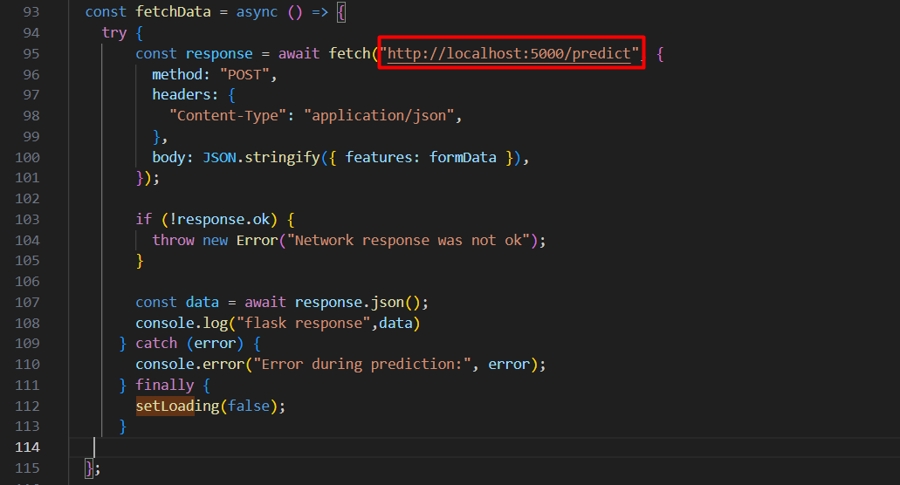
Project Architecture Deployment
On this screen we find our front-end project code and here we consuming the back-end API (flask) where our model was loaded and exposed.
‹#›
Notes:
B: Attack percentage in the whole testing dataset.

Slide 57
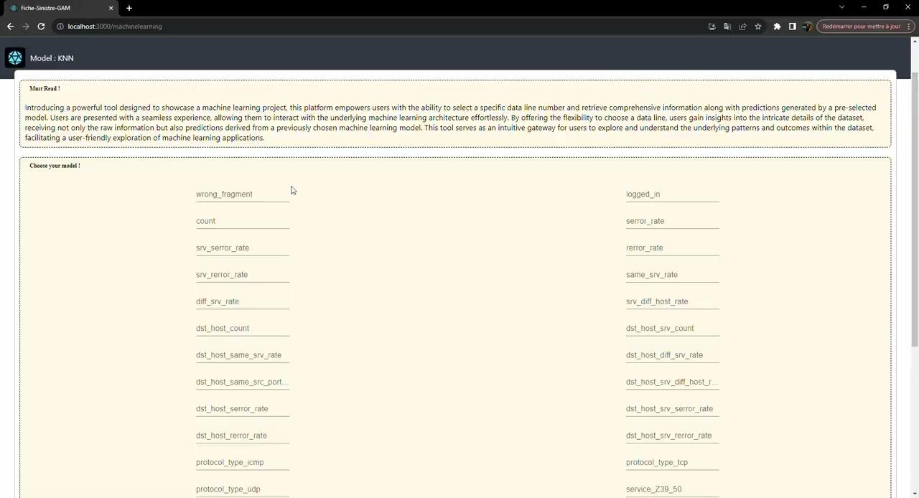
Project Architecture Deployment
Use case where the data refers to an anomaly data.
‹#›
Notes:
B: Attack percentage in the whole testing dataset.

Slide 58
THANK YOU !
Do you have any questions?

